Slide 1
‘A day in the life of a data scientist: Predicting climate change with python’
Lakshmi Jaganathan
Darshna Shah

Slide 2
Agenda
What is machine learning?
What questions can machine learning answer?
What machine learning is not
Exercise
Types of machine learning
A data science project workflow
Task: Explore trends in climate change and develop a model to predict the increase in the Earth’s temperature.

Slide 3


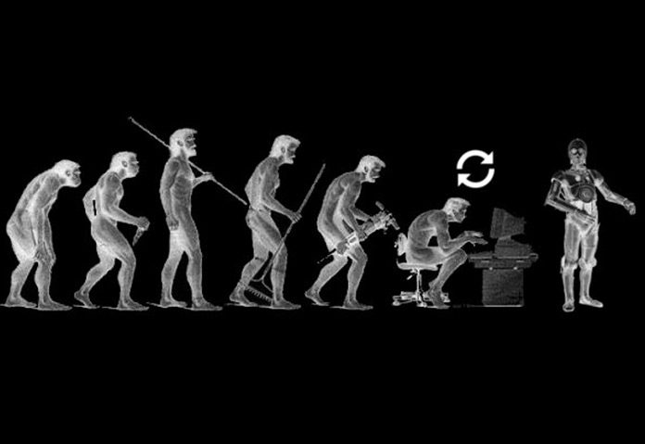
What is machine learning
At a basic level machine learning explores the construction and use of algorithms that can learn from data
Notes:
At a basic level machine learning explores the construction and use of algorithms that can learn from data
We can say a machine learning model is able to learn when its performance improves with additional data

Slide 4
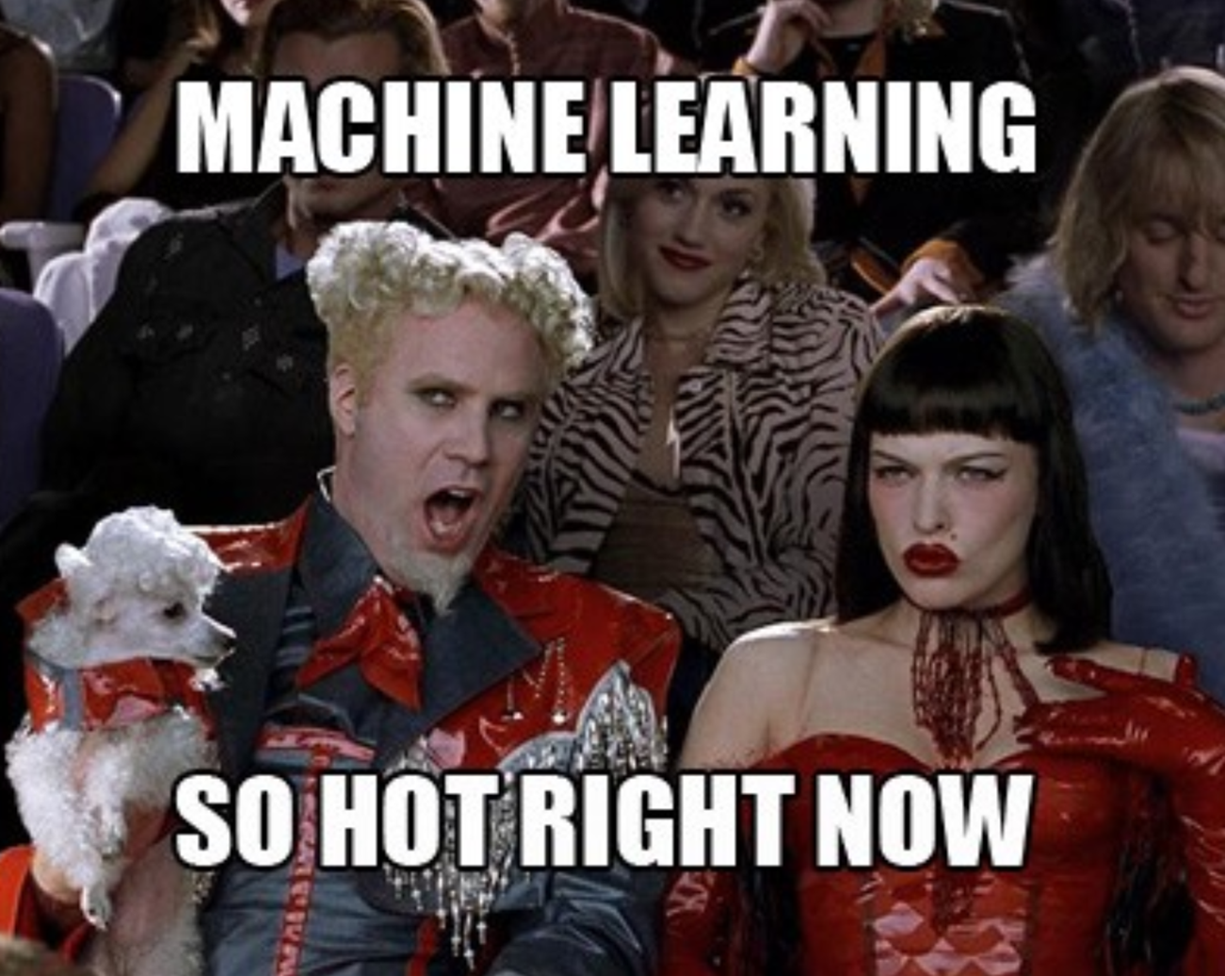

What questions can machine learning answer
Spam detection
Credit card fraud detection
Speech recognition (chat bots)
Product recommendation
Medical diagnosis
Stock trading
Customer segmentation
Self driving cars

Slide 5

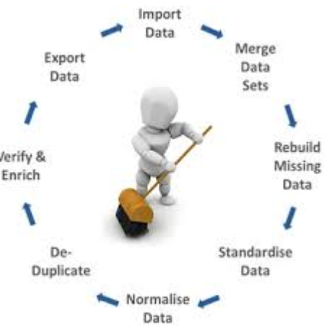
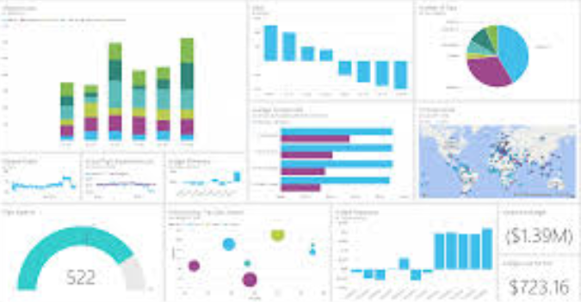
What machine learning is not
Calculating average height of a population
Cleaning data
Most other informative/ exploratory statistics (median, frequency, etc)

Slide 6

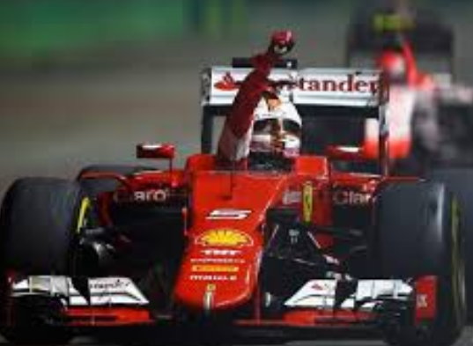
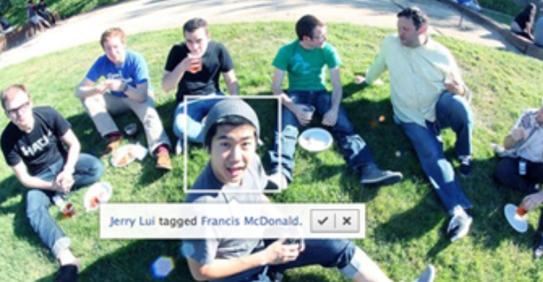

What is machine Learning Exercise
Determine whether an incoming email is spam or not?
Obtain the name of last year’s F1 champion
Automatically tagging your new Facebook photos
Select the student with the highest grade on a statistics course
Notes:
Ask audience to classify which scenarios are examples of machine learning

Slide 7

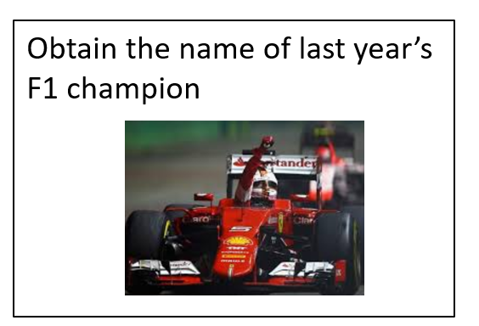
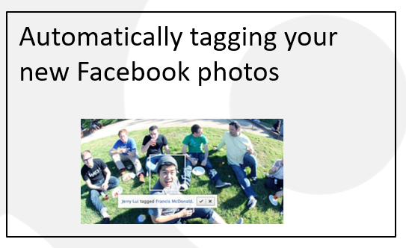
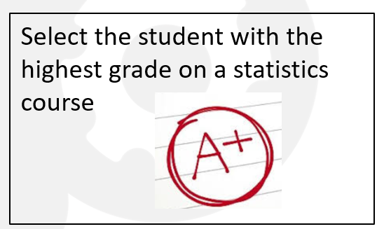
What is machine learning? The answers

Slide 8
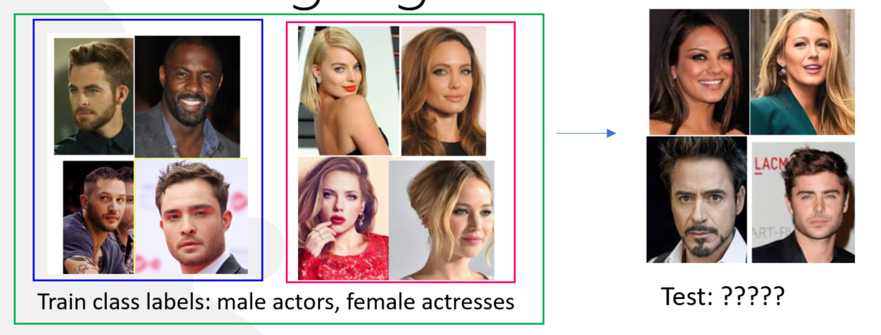
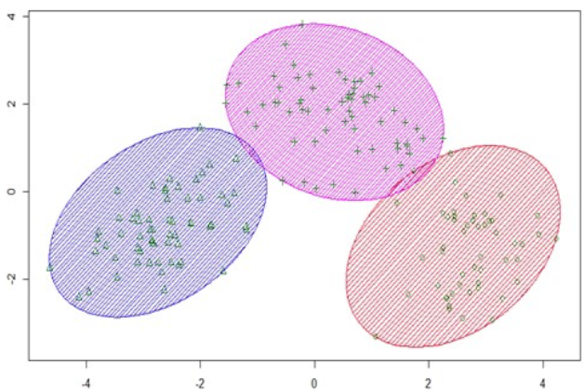

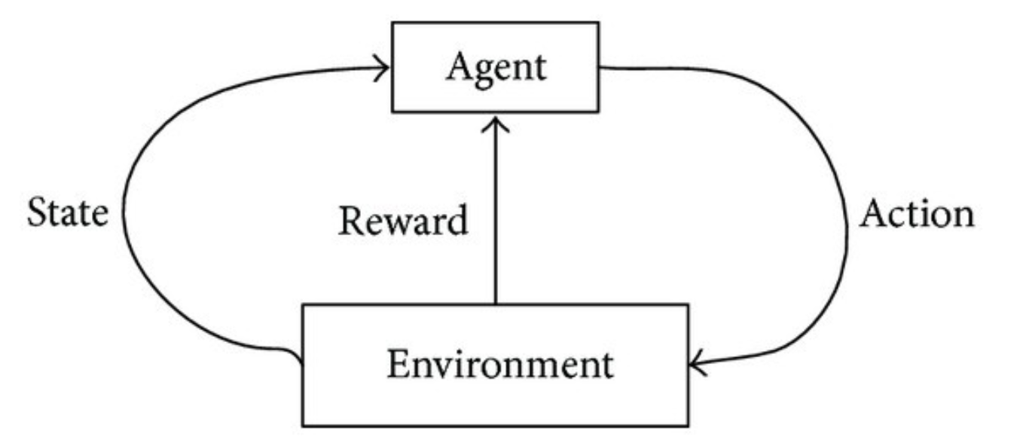
Types of machine learning algorithms
Supervised learning
Regression
Classification
Unsupervised learning
Reinforcement learning
trains
Boats/ships
planes

Slide 9
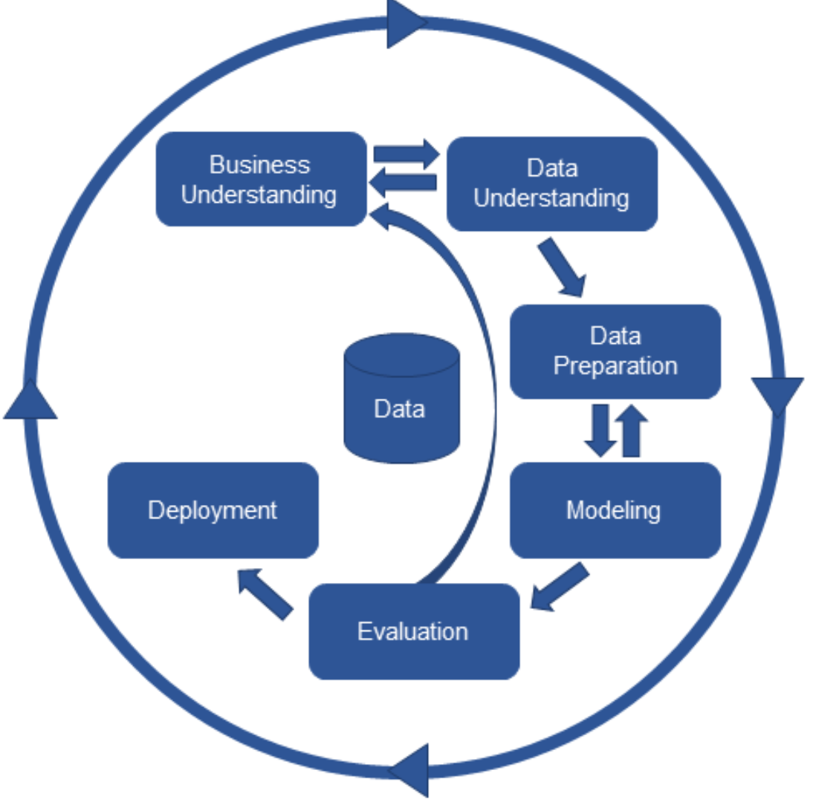
CRISP- DM: developing machine learning models

Slide 10

Task: Explore trends in climate change and develop a model to predict the increase in the Earth’s temperature.
Notes:
Goal: There are many advanced analytical techniques that can be explored within python. But out goal today is to give an introduction to machine learning in python using popular packages like scikit learn, pandas and matplotlib and get you excited to learn more about machine learning and practising python.

Slide 11
Introduction to ML with python workshop
Install Anaconda
The environment: scripts, console, global environment
Script
Help: Google/ stack overflow
Install packages
Read csv (check dimensions, structure, summary)
Explore data
Split data into train and test
Evaluate model performance

Slide 12
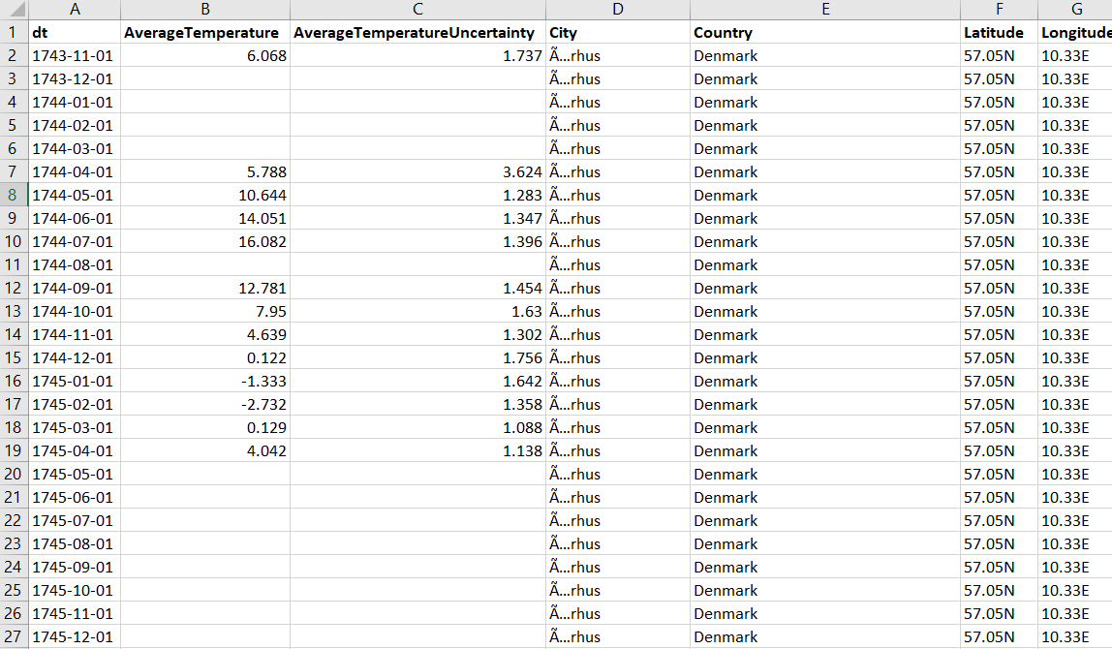
The Data (Global land temperature by city)

Slide 13
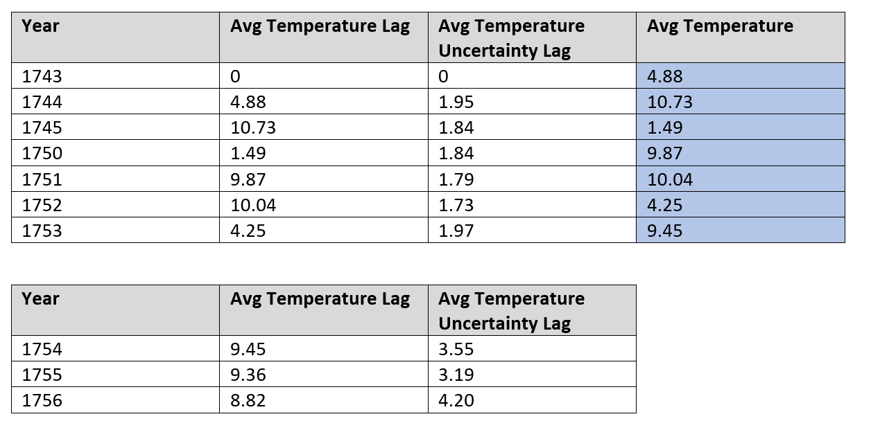
Splitting the data for training and testing
70%
30%

Slide 14
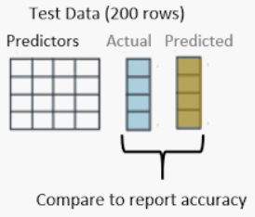
Model evaluation: accuracy vs R2
Blog post on different evaluation metrics
Mean Absolute Error
R2: Ranges between 0 and 1. Ideal performance range from 0.7 to 0.9. Models that perform below 0.5 are worse than taking a chance guess. Models that perform at 1 are ‘overfit’ meaning there are not generalisable to data that does not look like the data the model was developed from.

Slide 15
Github
Clone
Open the notebook
Change the working directory
Run cell to read data
Continue exploring
Developing a model

Slide 16
References/useful resources
Data camp introduction to machine learning
Machine learning mastery- practical machine learning problems
Types of machine learning
Kaggle: Predicting the Earth’s temperature as climate change advances
Blog post on different model evaluation metrics

